Slide 1
Assembly Instructions For Pinball Bumper
Epic Robotz, Fall 2022

Slide 2
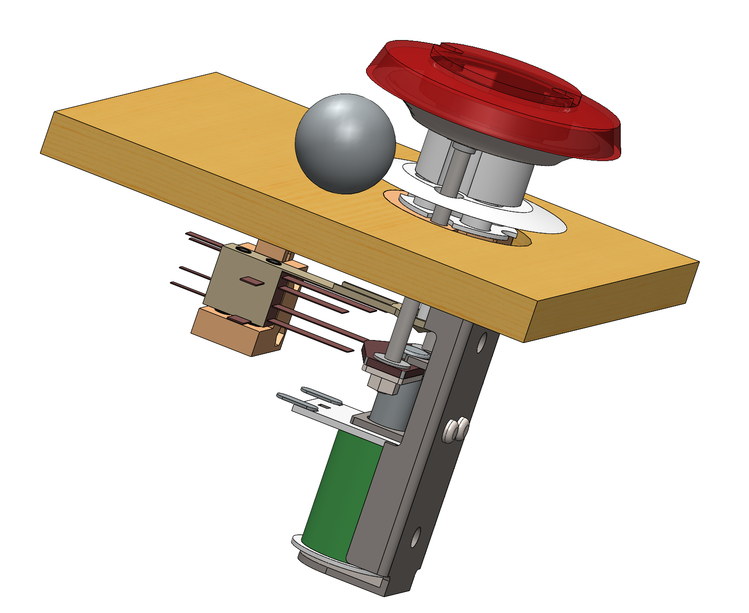
Overview
3D Parts Developed to Aid Installation and Adjustment of Switch
Bumper should be located by drilling a 1.75 inch Hole in Playing surface
This component is DIFFICULT to install correctly – This step-by-step guide should help

Slide 3
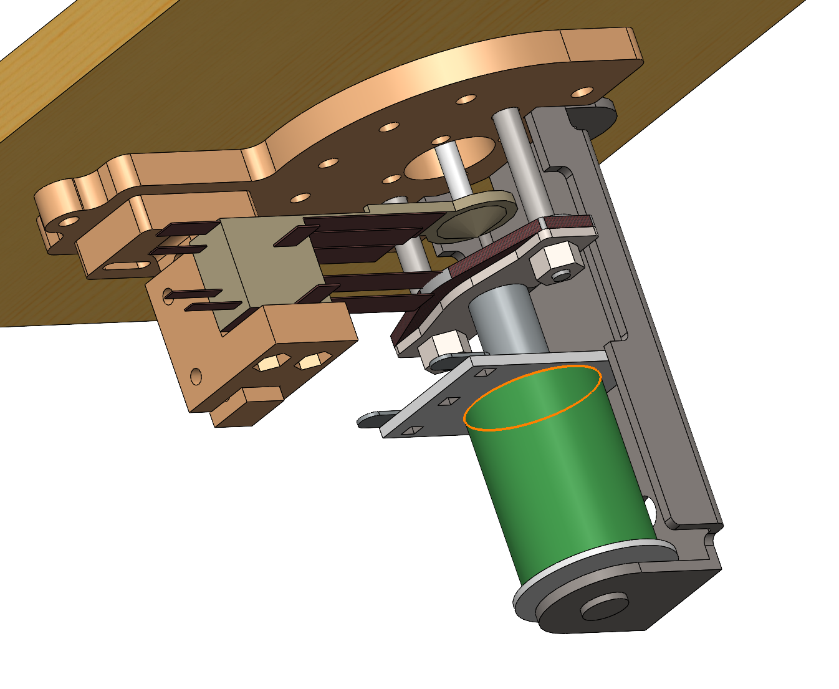
Overview
Underside of playing surface
The biggest problem is to accurately adjust the “Spoon” so that the pinball will activate the solenoid from all sides. The switch holder and Adjustment Features help overcome this challenge.
Spoon
Solenoid
Assembly
Switch Holder and
Adjustment Features

Slide 4
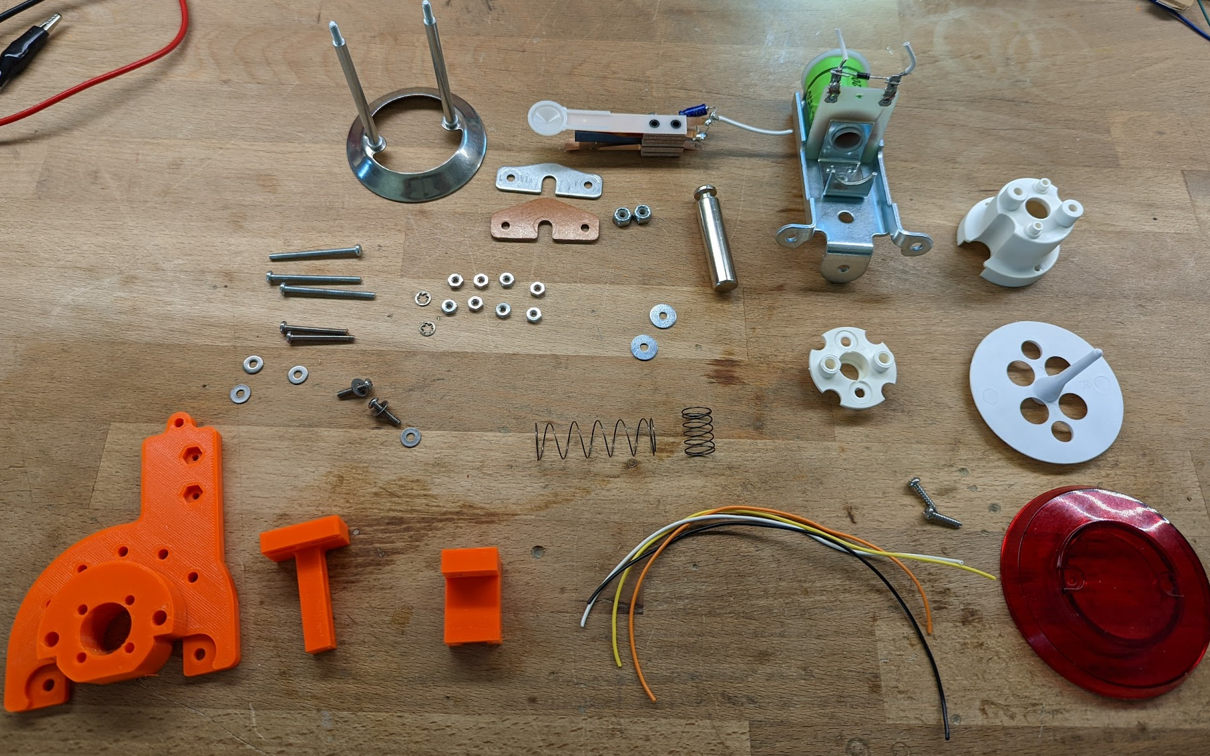
Parts
Hardware for Striker
Strike Ring and Shaft
Connector Plate
Insulator Plate
#6 Lock Nuts, 2x
#6 Washers, x2
Spoon Switch Asm
Solenoid Shaft
Solenoid Asm
Solenoid Spring
General Mounting Hardware:
#4 Screws, 1.5” Long, x4
#4 Screws, 0.5” Long, x2
#4 Lock Washers, x2
#4 Washers, x2
#6 Wood Screws:
1/2“ Long, 5/8” Long
Cup
Cup Guide
Umbrella
Top Screws
Top
3D Printed Parts:
F22-PM-3020
F22-PM-3021
F22-PM-3022
26 Gauge, 8” Long, Stranded Wire
(Black, Orange, White, Yellow)
Umbrella Spring

Slide 5
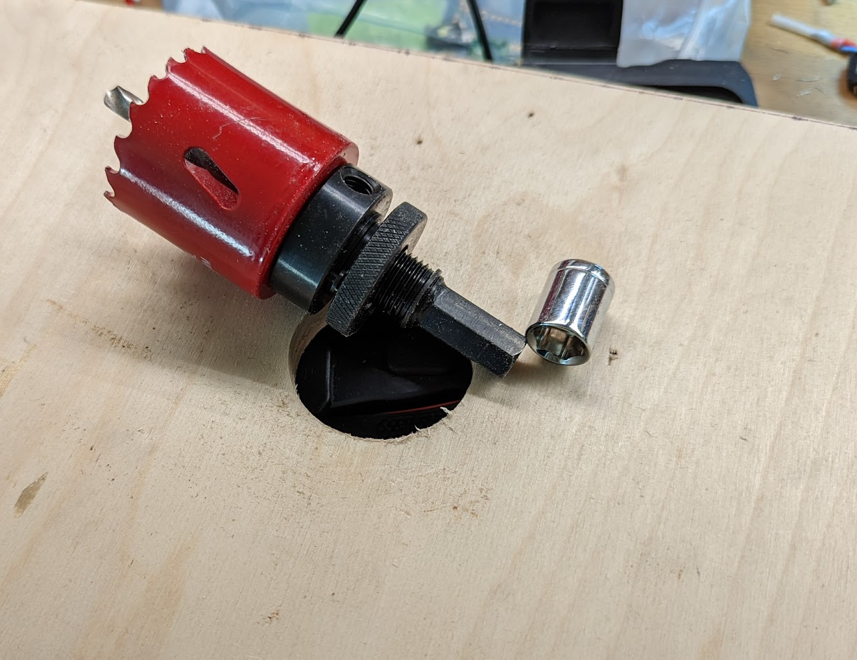
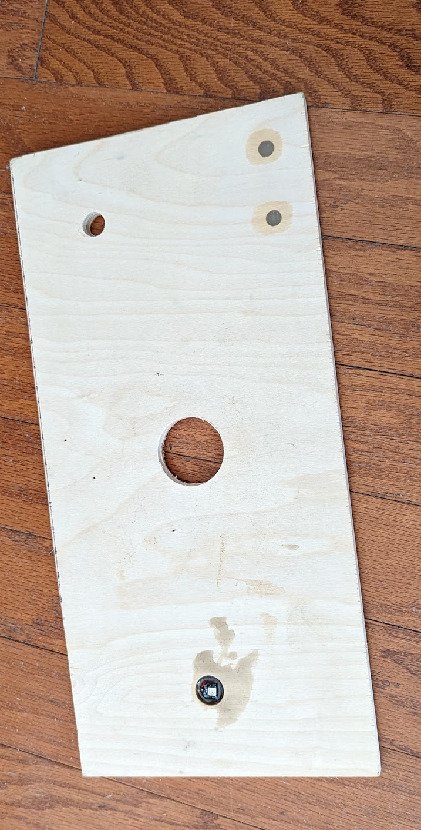
Step 1: Cut the 1.75” Hole
Locate the center of where the bumper is to be placed.
Drill at 1.75” Hole all the way though the playing surface at that location.
Use the provided 1.75” Hole Saw.
If the shank of the hole saw is too big for your drill, use a socket as an adapter.

Slide 6
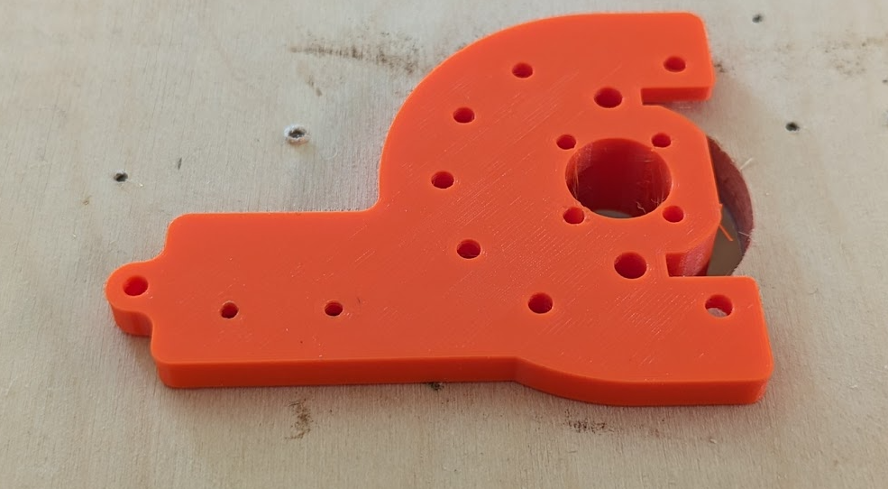
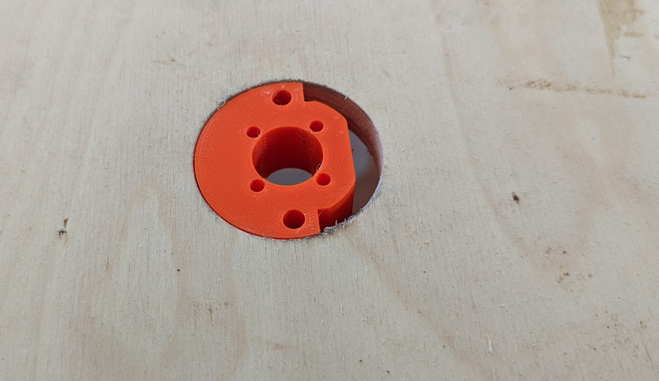
Step 2: Fit the 3D Part to the 1.75 Inch Hole
Make sure the 3D Printed part can fit tight against the back of the playing surface and flush on the front of the playing surface.
On the back of the playing surface you can rotate the 3D part in any direction you need to, so that there is room for other items in the pinball machine.
You may need to sand the hole to get a nice fit.
Bottom View – i.e., under the playing field
Top View of playing surface

Slide 7
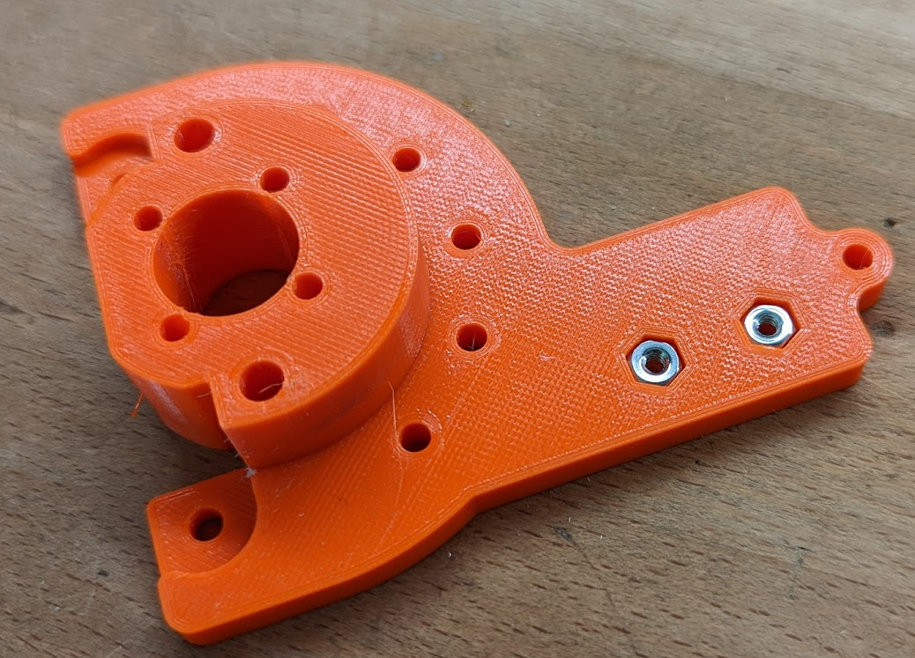
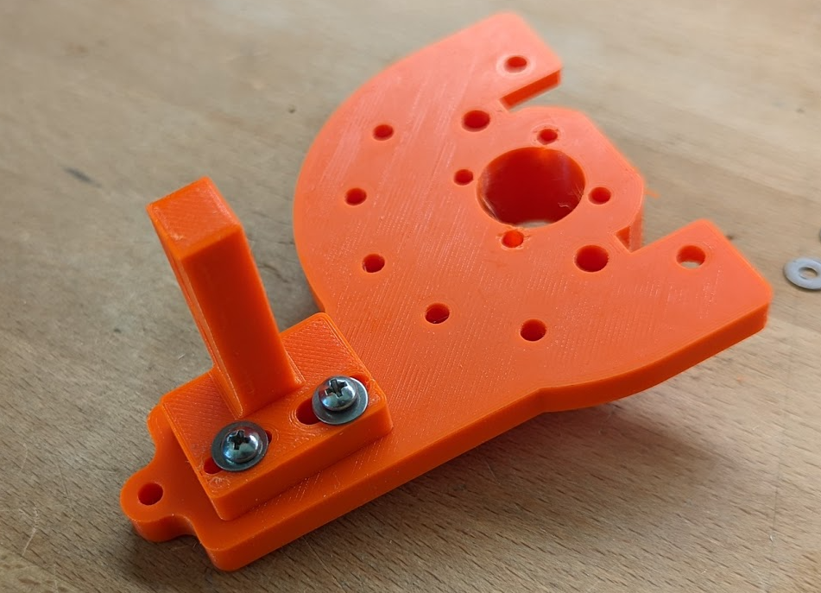
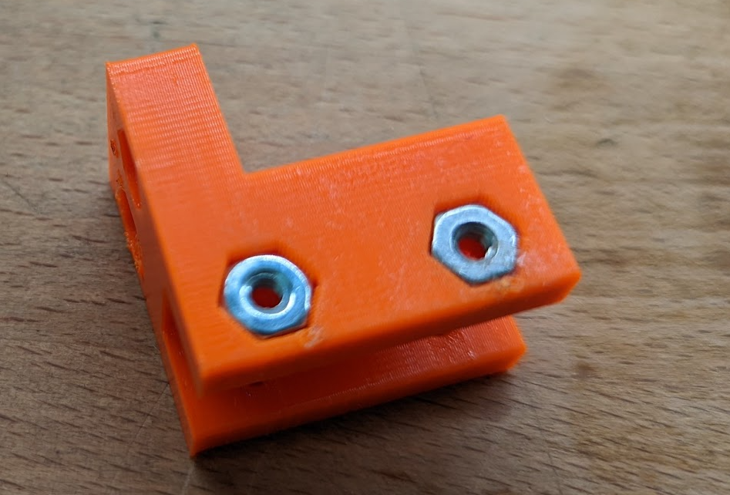
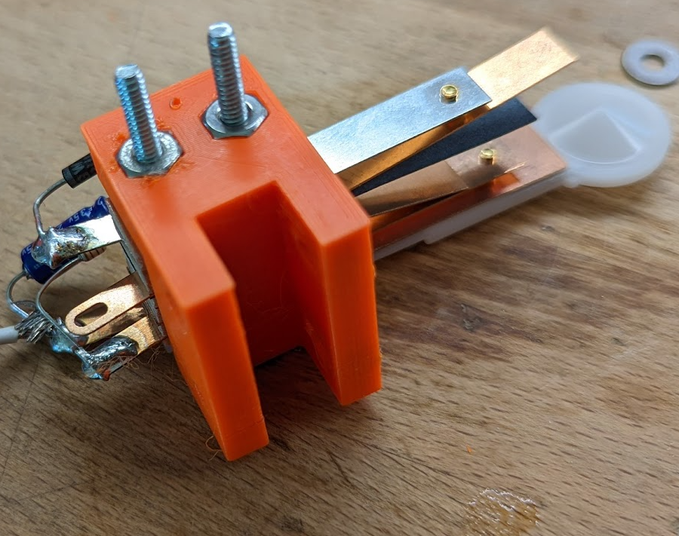
Step 3: Assemble the 3D Printed Parts
Insert 6 #4 Nuts into the various 3D parts.
Install the Post as shown in Photo 2. Use #4, 1/2 inch Screws and #4 washers.
Then install the Spoon Switch Assembly
As shown in the photo. Note the orientation of the Spoon.
Photo 1. Main Mount
Photo 2. Post installed on Main Mount
Photo 3. Switch Holder with #4 Nuts
Photo 4. Spoon Asm Mounted to Switch Holder

Slide 8
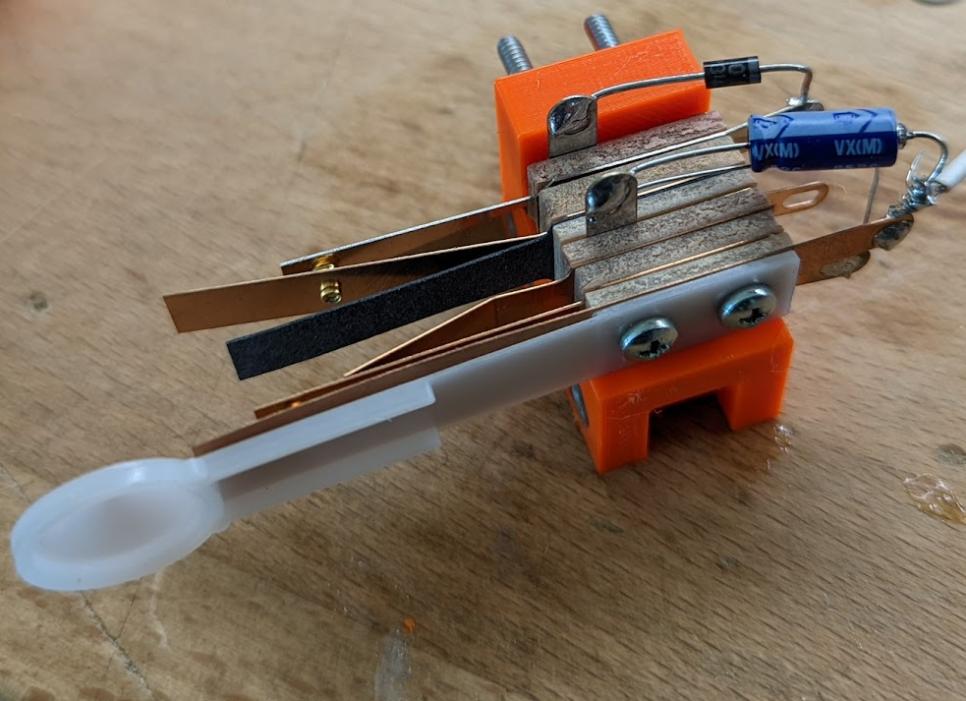
Step 3, Continued
Use 1.25 or 1.125 Inch #4 screws if your able to find them.
Here, 1.5 inch screws were used.
Spoon Switch Assembly installed on 3D Printed Part

Slide 9
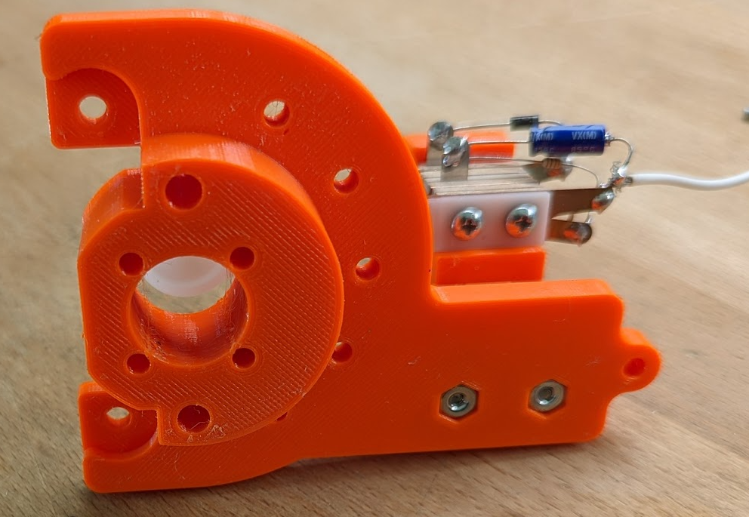
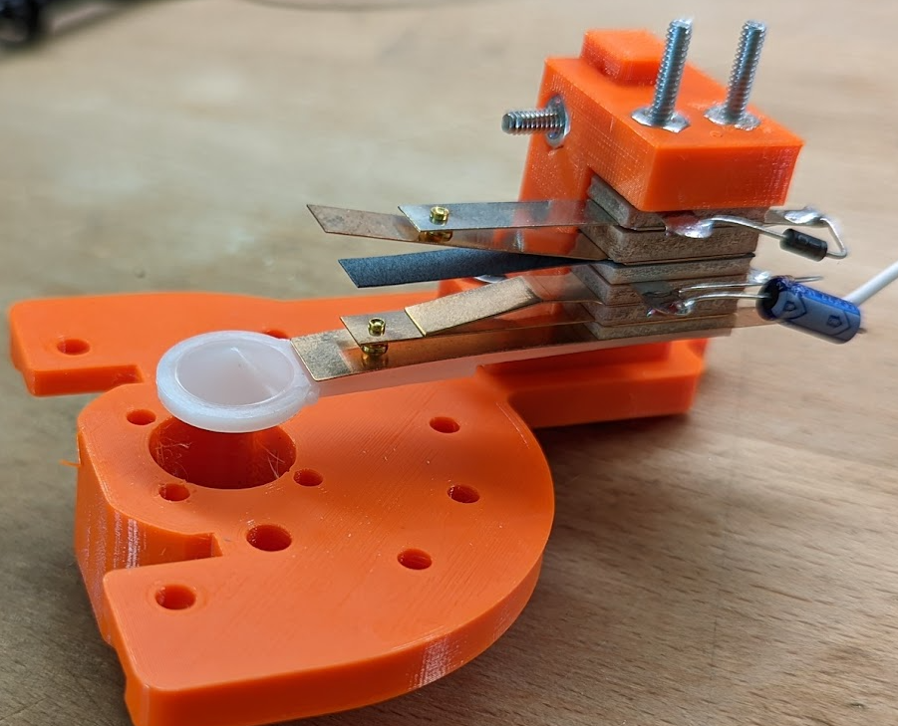
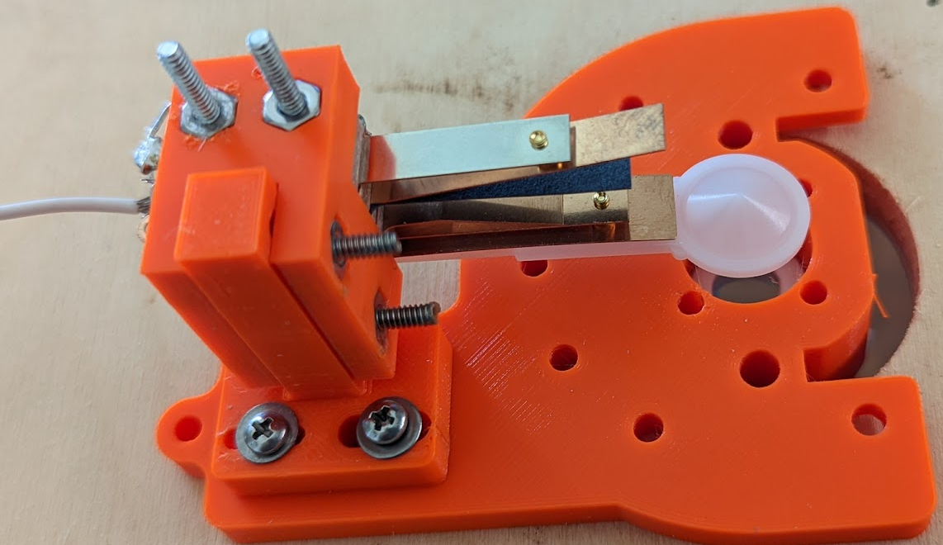
Step 3, Continued
Screw all the 3D parts together with the Spoon Assembly.
Try to center the parts in their respective
Slots.
Don’t over tighten, since final adjustments come later.

Slide 10
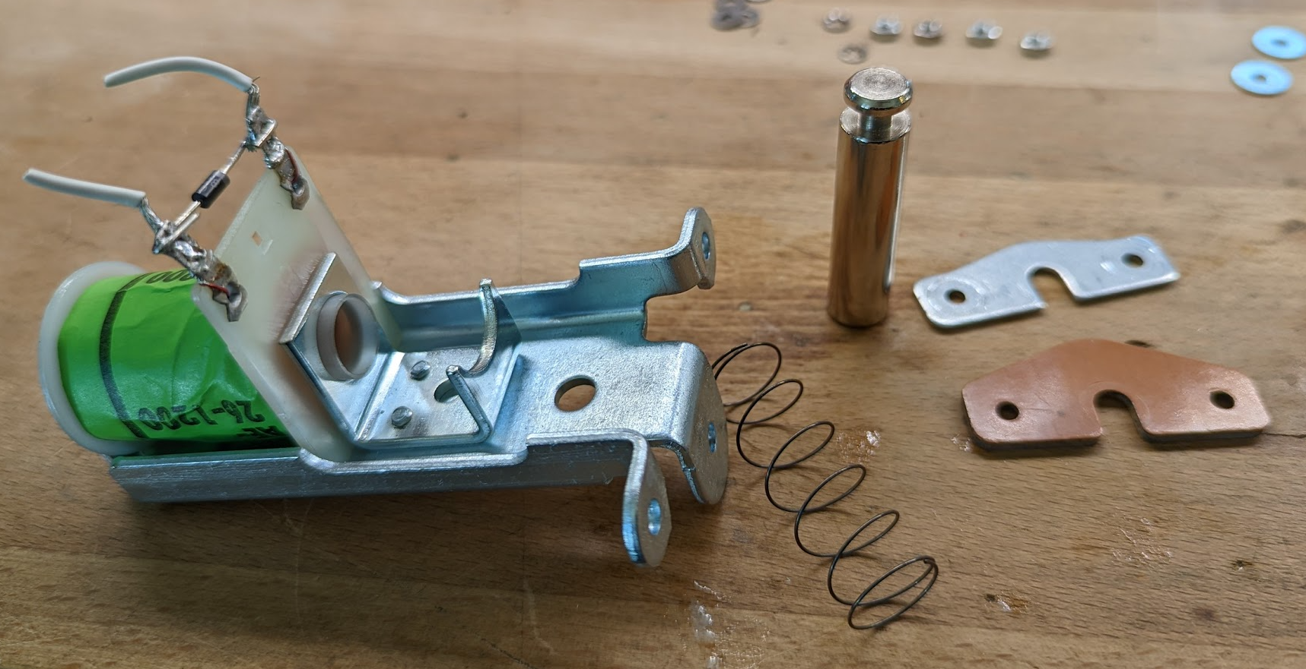
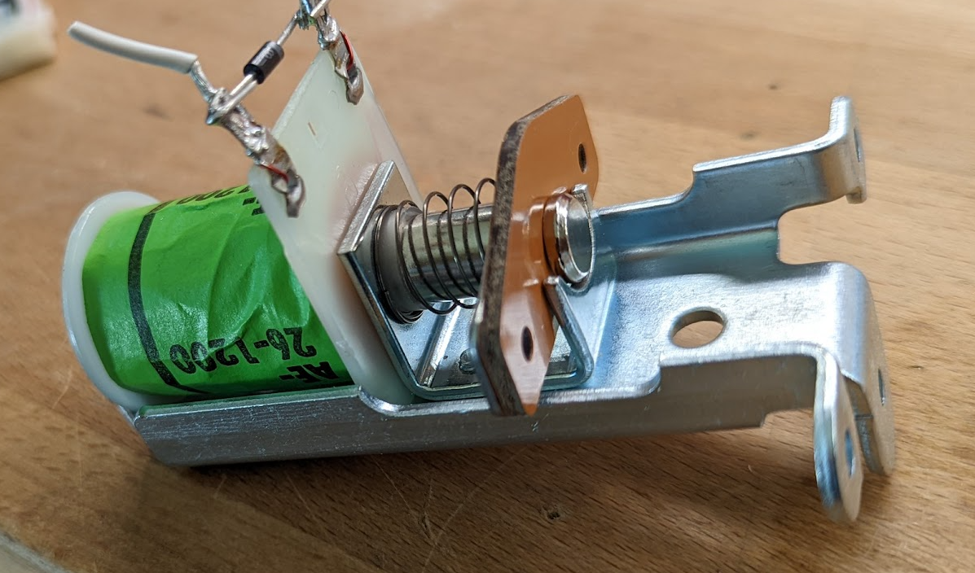
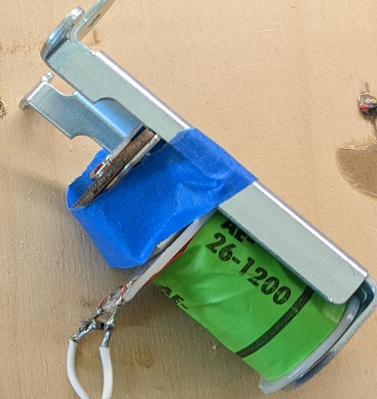
Step 4: Assemble the Solenoid
Assemble the Solenoid by putting the spring on the shaft, inserting the shaft into the coil, and then inserting the two plates below the stop bracket.
Be sure that the insulator plate is on top as shown.
Use blue painter tape to hold the assembly together until the striker shaft is installed .
1
2
3

Slide 11
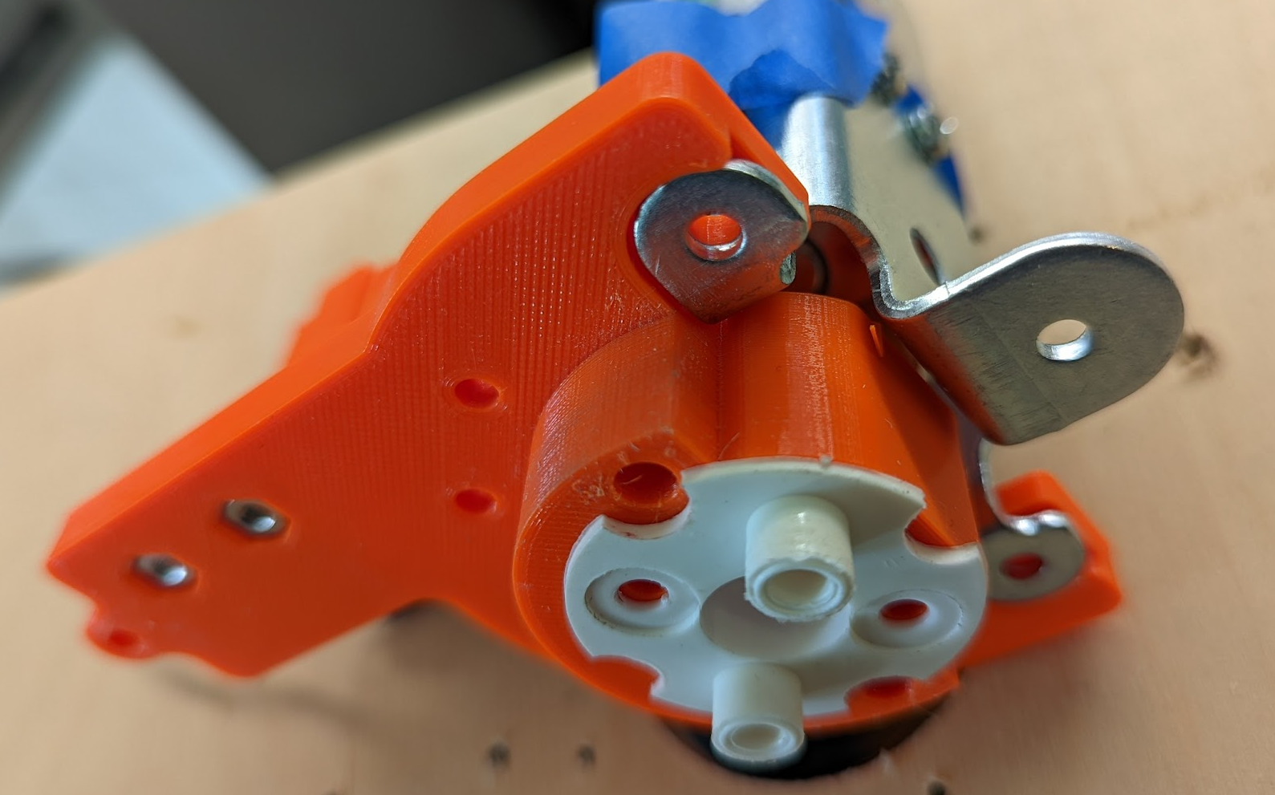
Step 5: Join the Solenoid Asm to the Mount
Join the 3D printed plate and the
Solenoid Assembly.
At this point there is no hardware that holds these parts together; but note how the tabs of the Solenoid Assembly fits into the 3D printed part.
Also insert the cup guide into the 3D printed part and orientate it as shown.

Slide 12
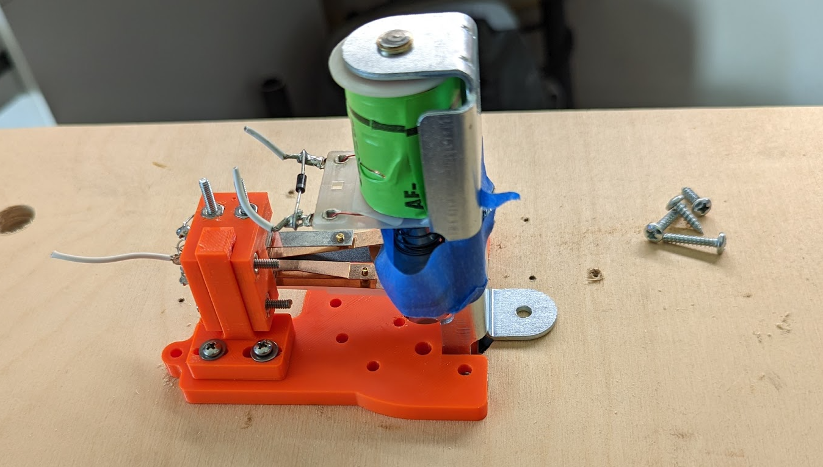
Step 6: Attach the Asm to the Playing Field
Use 0.75” Long screw here (hole not visible)
Position the Assembly over the 1.75-inch hole, as shown.
Use #6, 0.75 inch long screws at the locations in blue.
Use #6 0.5 inch long screws at the location in Red
Pilot drill all holes with 3/32 inch drill. Only drill to a depth of about 0.375 inches. DO NOT drill through to the playing surface. (Put painter’s tape on the drill bit at the correct depth as a guide.)
You may need to place the assembly, mark the holes, then remove the assembly to drill the pilot holes.
Use 0.5 Long screw here
Use 0.75” Long screws here

Slide 13
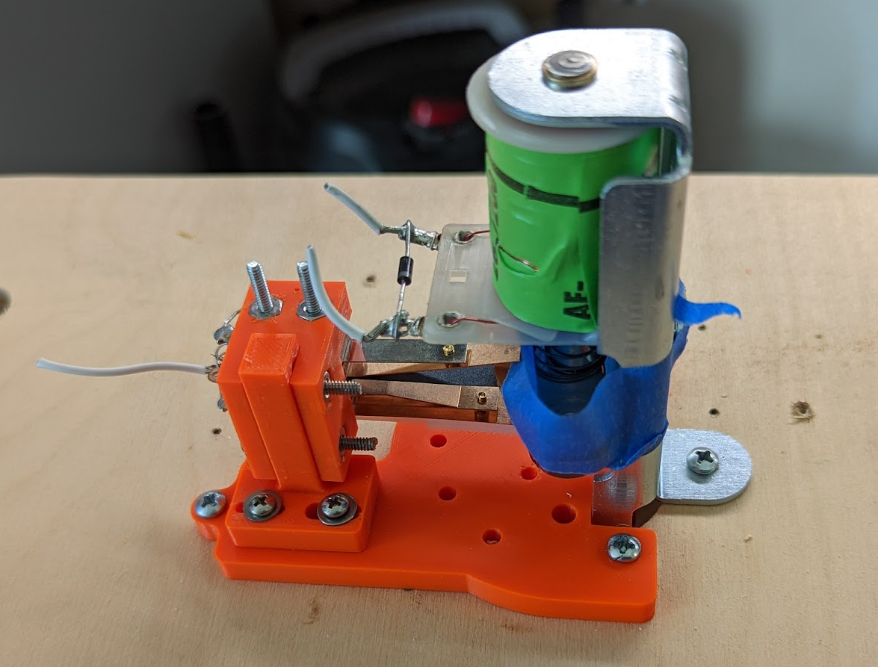
Step 6, Continued
View after attaching the Assembly to the Playing Field

Slide 14
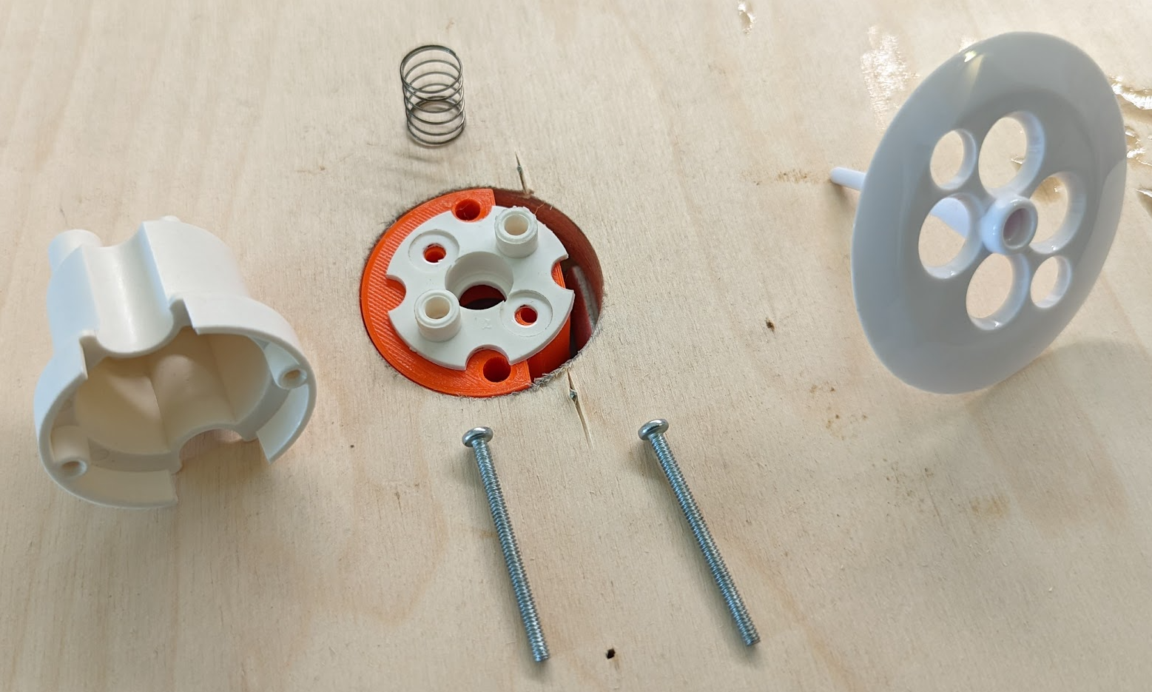
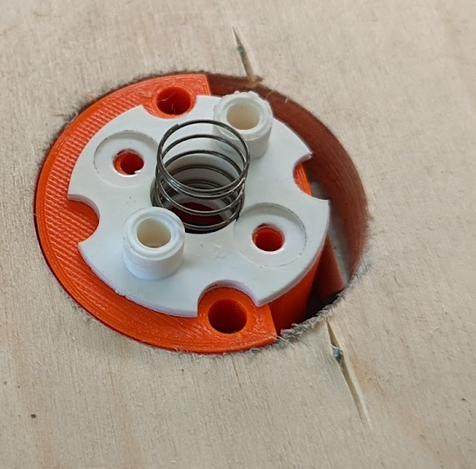
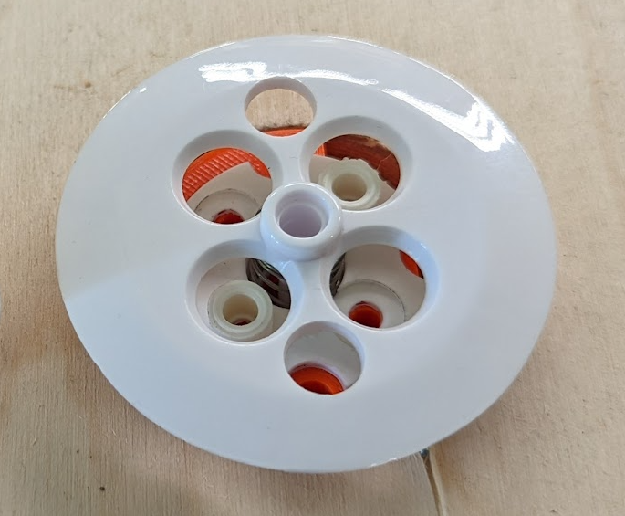
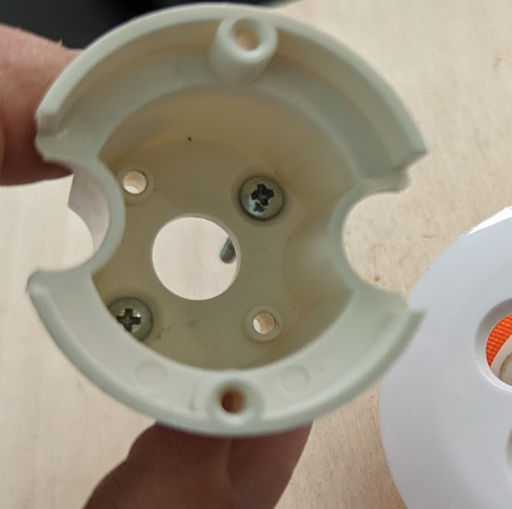
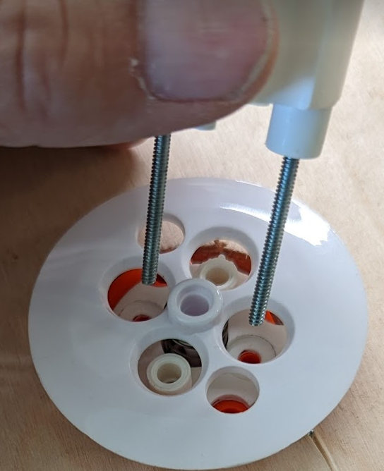
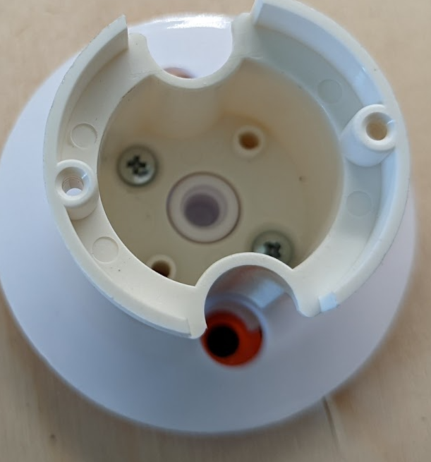
Step 7: Assembling the Cup and Umbrella
1. Get the parts. Use #4, 1.5 inch long screws
2. Put the Umbrella spring in the center hole.
3. Place Umbrella in orientation shown.
4. Put the screws in the holes with the boss
underneath.
5. Orient as shown
6. Install Cup with screws on Guide plate. Push the screws
Into the 3D printed mount. They should protrude below.

Slide 15
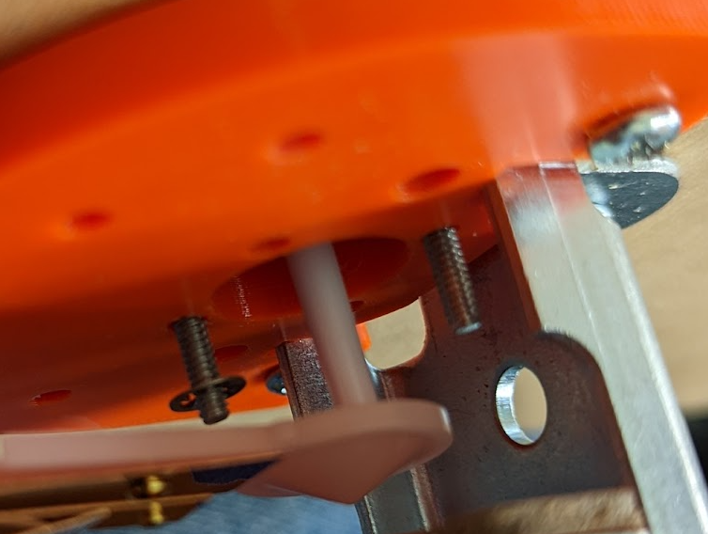
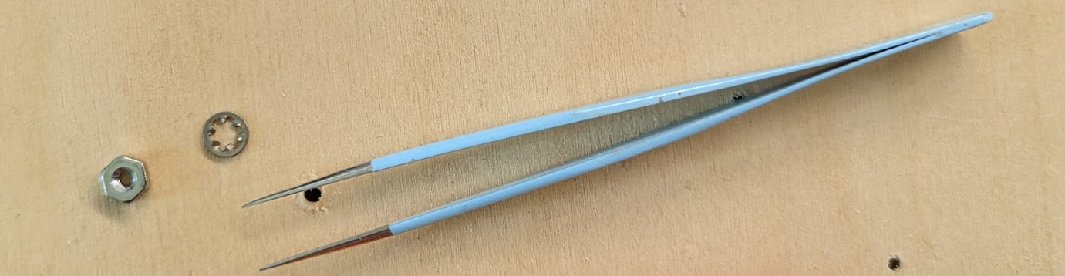
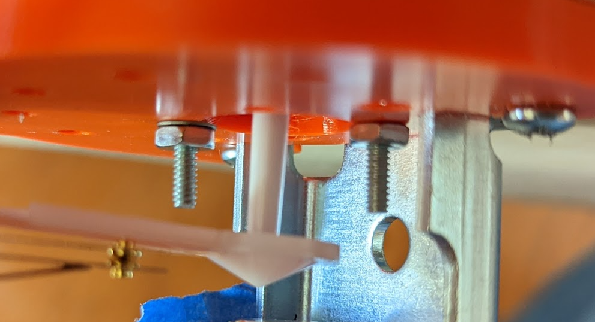
Step 7. Continued.
Secure the cup with #4 lock washers and nuts.
It is difficult to install these. Tweezers and/or long needle nose plyers might be helpful. Painter’s tape might help too.
#4 Screws from cup protruding below.
All Done!

Slide 16
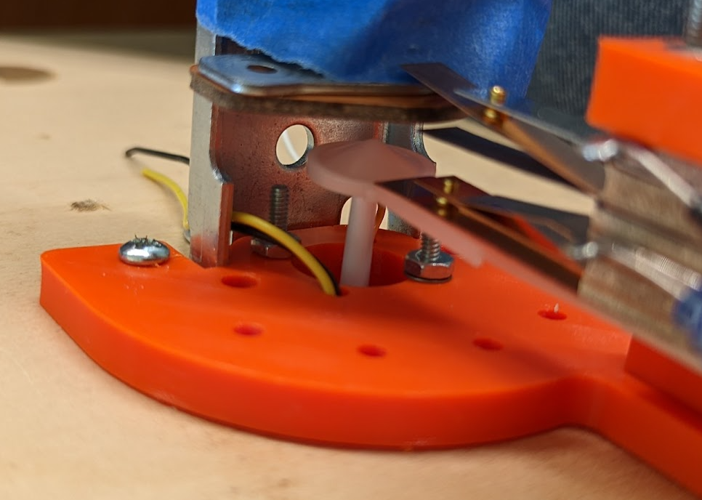
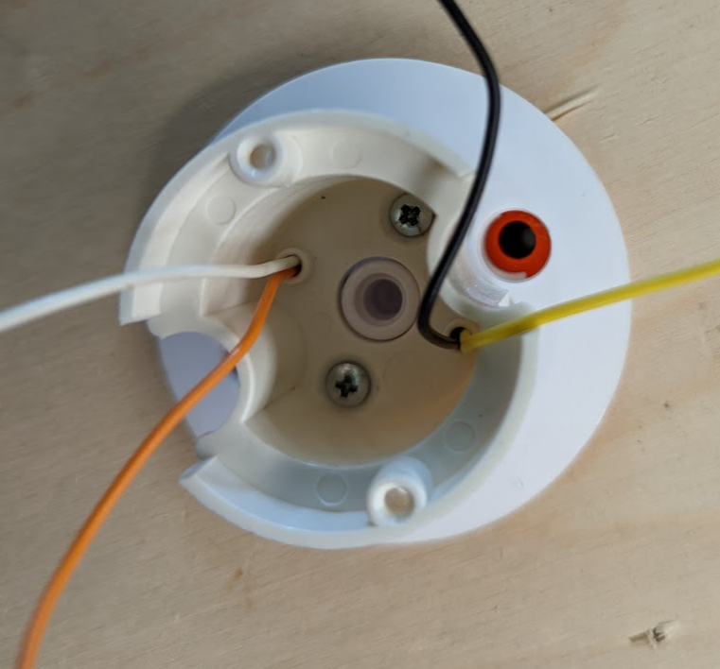
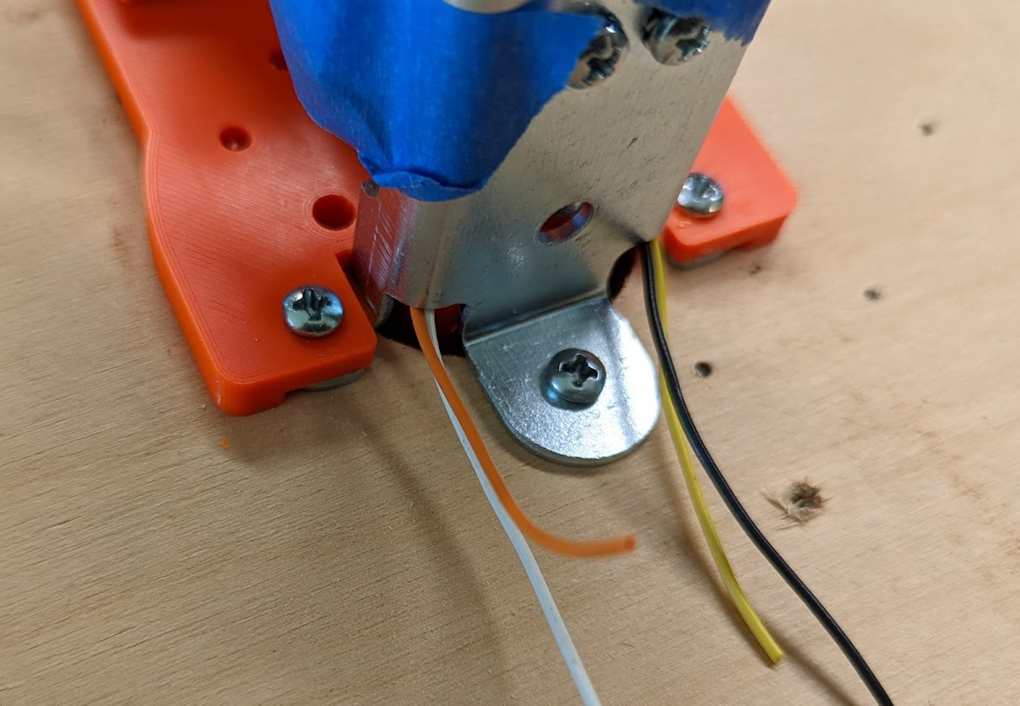
Step 8: Installing Wires for LEDs and Lights
Install the 26 Gauge Wire in the two remaining holes in the cup.
This is a tight fit. Use needle nose pliers to push and pull the wires into place.
All four wires are necessary… Match the colors on each side as shown.
Route the wires to the rear of the Assembly as shown so that they do not interfere with the umbrella, spoon, or striker shaft.
Leave about 2” above the cup for later work.

Slide 17
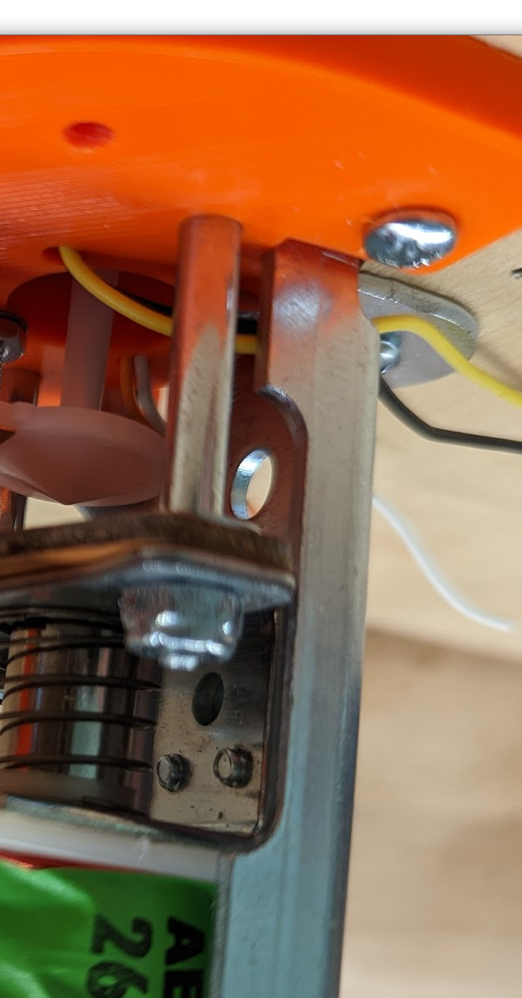
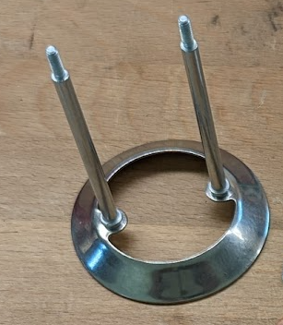
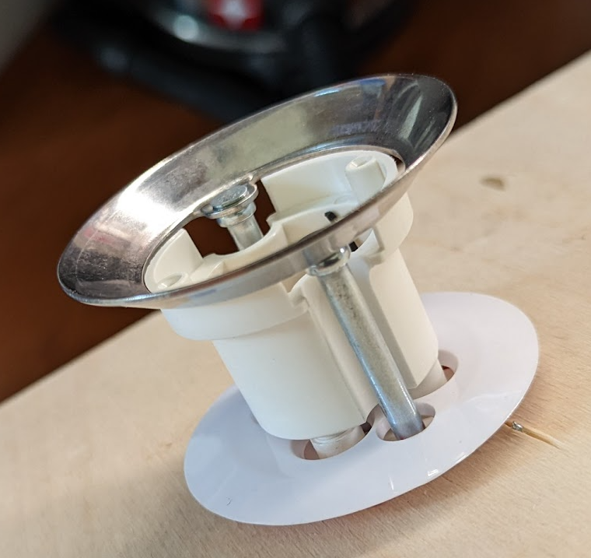
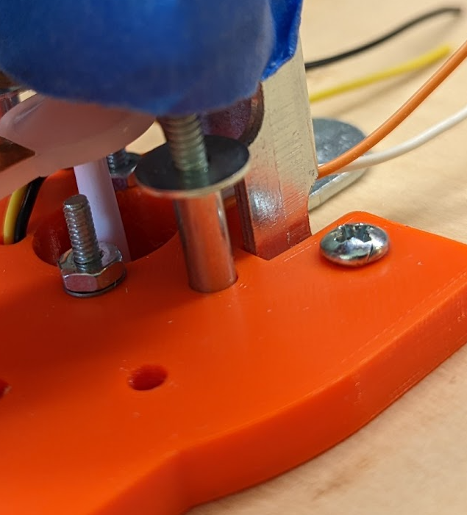
Step 9: Install the Striker Ring
1. Find the Striker Ring.
2. It should fit over the cup and slide into place without any sticking.
3. Before inserting the threads through the plates, install #6 washers.
#6 Washer. Both sides.
#6 Lock Nuts. Both sides.
4. Use #6 Lock Nuts to attach the shafts to the plates. Make it a tight!

Slide 18
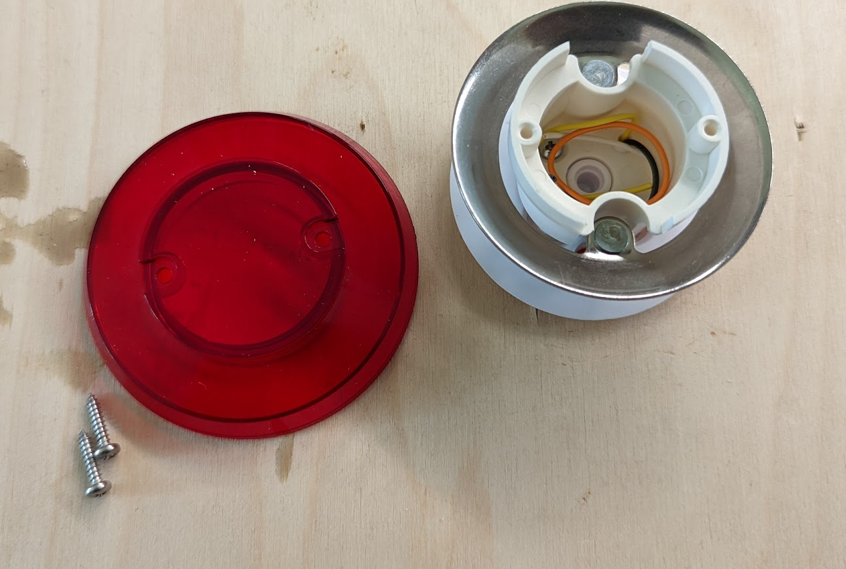
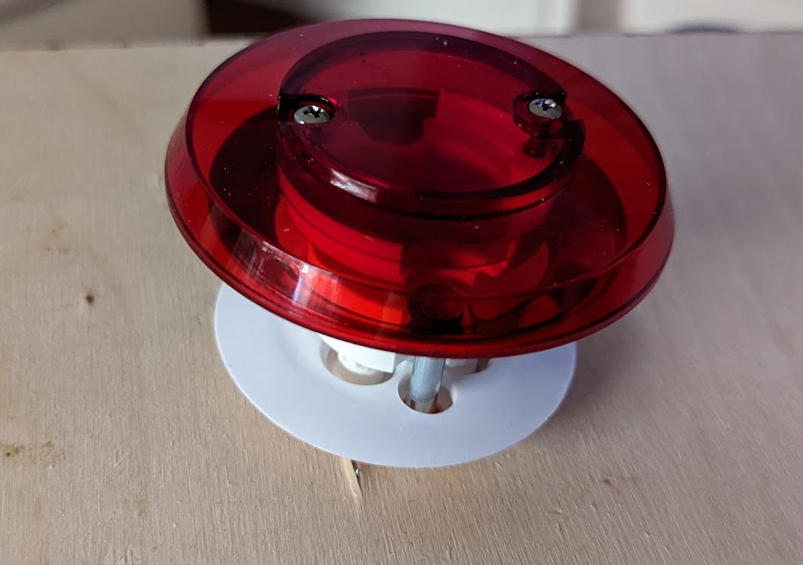
Step 10: Install the Top Hat
Install the top hat with the two metal screws.

Slide 19
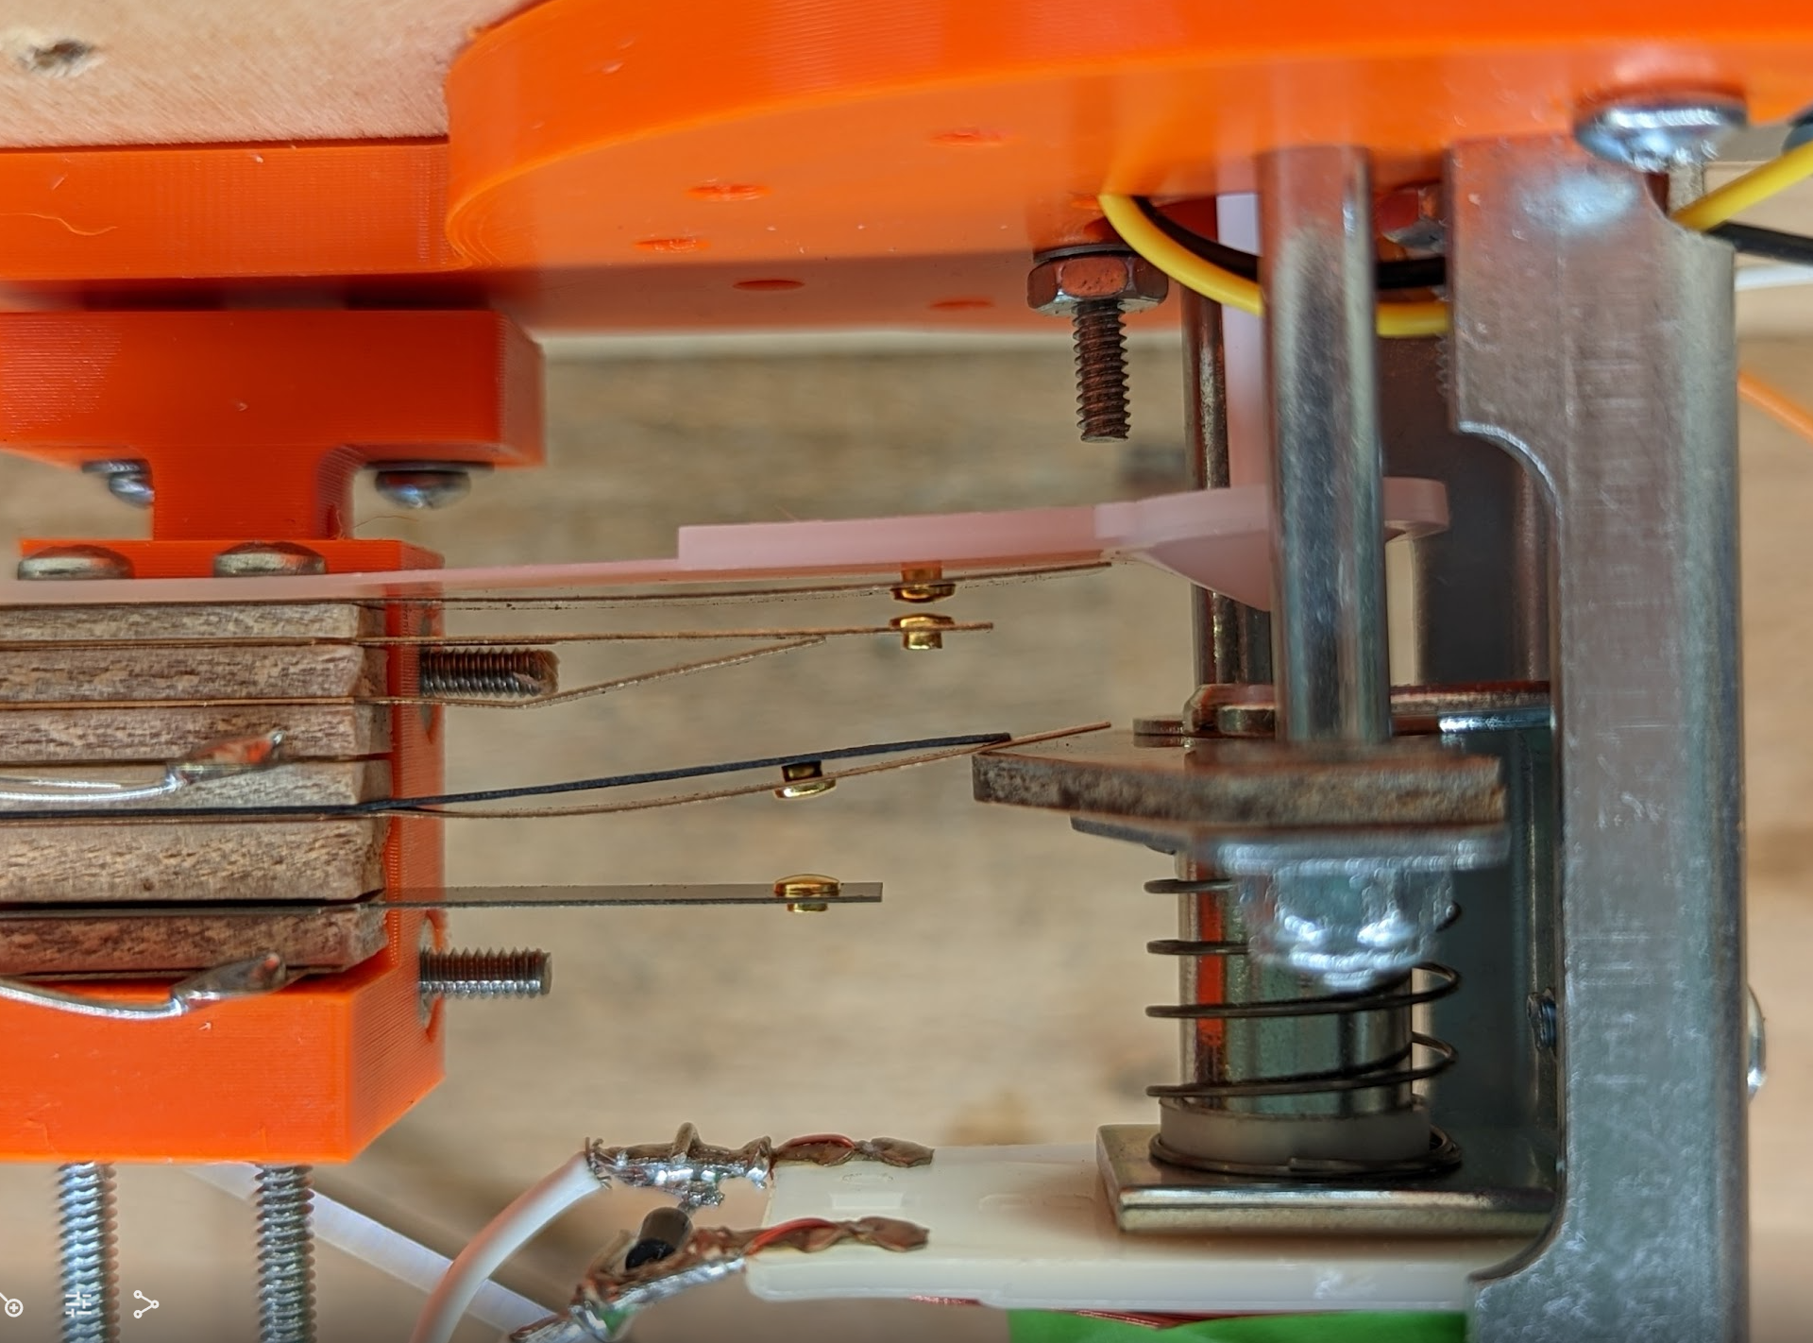
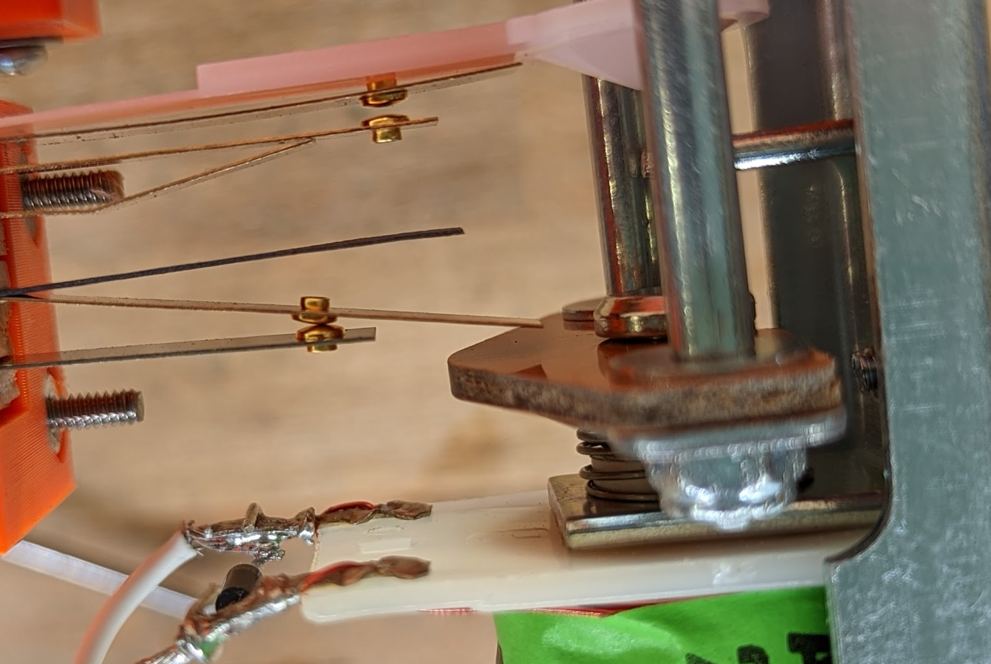
Step 11: Check the EOS Switch
Solenoid Not Energized, EOS switch Open
Examine the EOS Switch:
Ensure that in the un-energized state the EOS switch is in the position shown. If the solenoid is energized, then the EOS switch should make contact. If this is not the case, then then entire spoon assembly must be removed and reinstalled with the EOS switch tab bent up and positioned on the insulated plate as shown (see next slide for hints on removing the Spoon Assembly).
EOS = End of Swing
Solenoid Energized, EOS switch closed
EOS Switch Tab
On topside of Insulated Plate
EOS Switch Contact

Slide 20
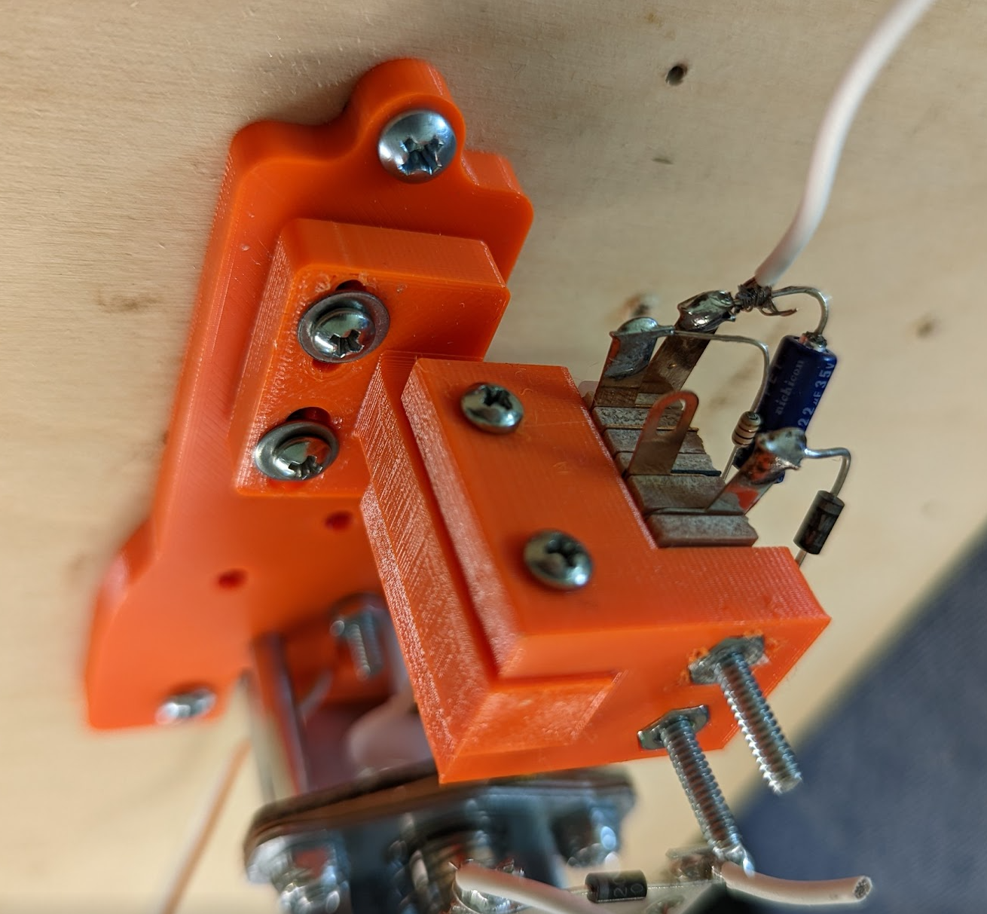
STEP 11. Continued.
How to remove the Spoon Assembly
Remove these two screws, then remove the spoon assembly from the post.

Slide 21
Step 12: Adjust the Spoon
Spoon Switch Contact
Spoon Adjustment is Critical to the Proper Operation of the Bumper
1. It the non-active state, the umbrella stem must be in the exact center of the spoon. It should barley be touching the spoon…
2. In the non-active state, the spoon contact must be open by approximately 1/16 to 1/32 of an inch (as shown in the picture to the right).
3. In the non-active state, shaking the table or pounding on the table should not cause spoon contact to close.
4. Just the slightest of pressure on the umbrella (on the playing side) should cause the stem to move away from the center of the spoon and the spoon switch contact should then close. The umbrella should have the same sensitivity in all directions.
Make adjustments with the #4 screws on the post, and the main mount as shown in the next slide. The spoon should be able to move up and down, and in and out. A slight side-to-side adjustment can also be made with the screws on the main mount.
Spoon Sensor not activated in this picture.
The Umbrella Stem
Non-active state means the pinball is not touching the umbrella.
The Spoon

Slide 22
Step 12. Continued.
Use these screws to move the spoon in and out.
Use these screws to move the spoon up and down (or to remove the switch)
Note that the slot for this screw is larger than the shaft of the screw. This allows for some pivot action to move the spoon right or left.

